Slide 1

Multiple-pose Augmented Learning System
Manuel Cardenas
Advisors: José Vega, Dr. Thomas Bohné
Chair of Decentralized Systems Engineering
https://dse.in.tum.de/
15.06.2022 – 17.10.2022

Slide 2
Contents
Much content, little time
Motivation
State of the art
Research gap
Solution overview
Implementation
User study
Conclusion

Slide 3
Motivation
There is no perfect system to learn a new pose
Two options are widely available for a student:
Teacher:
The student receives guidance
But
Availability of the teacher is limited
A (high) price can be involved
Teacher cannot see everything in a group setting
Online Video:
Wide array of content
Always available
But
Student receives no guidance
Student can only correct via feeling

Slide 4
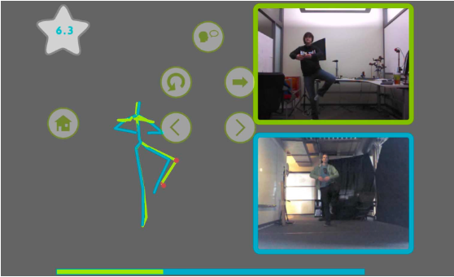
State of the Art
A new method has been under development
Technology is being used to allow both the availability of videos and the guidance of a teacher
YouMove [1]
Allows users to record and learn physical movement sequences.
Users receive feedback on their movements that changes as the user progresses
Pose recognition via Kinect [2]
Feedback via augmented mirror
YouMove’s terminal feedback screen. Source: [1]

Slide 5
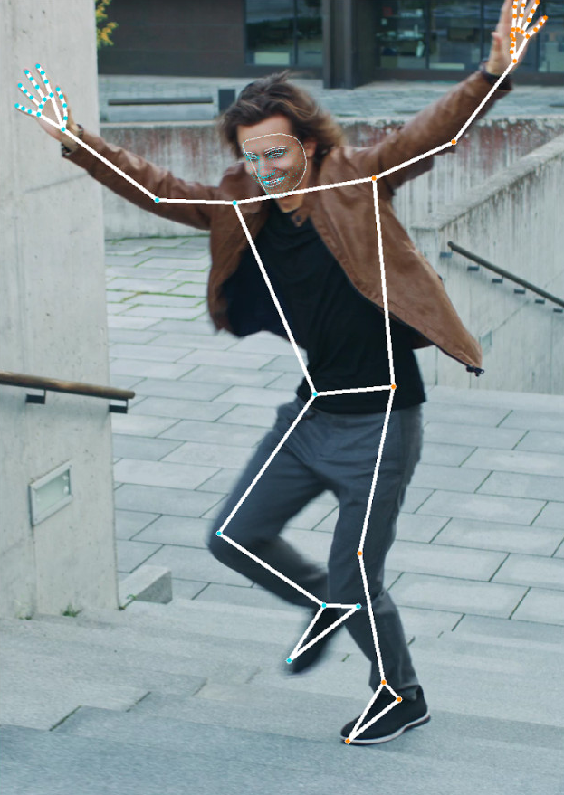

State of the Art
New pose recognition system developed by Google
Google’s Blaze Pose GHUM [3]: With only one (or a series of) image(s) of a person doing a pose, it can detect joints
All joints extracted by Google Blaze Pose GHUM. Source: [10]
Result of the framework. Source: [10]

Slide 6
Research Gap
A pose teaching system that uses simple hardware
A software is needed that
Simple hardware: just a camera, a screen and internet connection (what a normal laptop has)
Teaches a new pose following multimedia teaching principles
Allows change of pose with ease: not fixed to a single use case
Is easy to use
This thesis aimed to review the feasibility of such a system
To do so, a prototype was developed that followed the above requirements

Slide 7
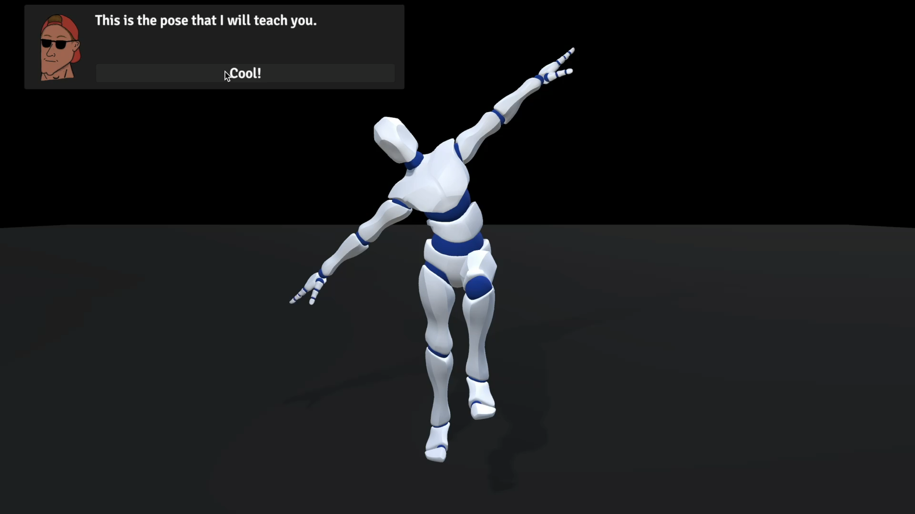
Solution overview
First, the final pose to be learned is displayed
Goal orientation: Final pose is presented. This improves learning results by building expectations
Gustavo guides the trainee.
A personalized agent is more effective than just objective instruction
Welcome screen recording from MPALS

Slide 8
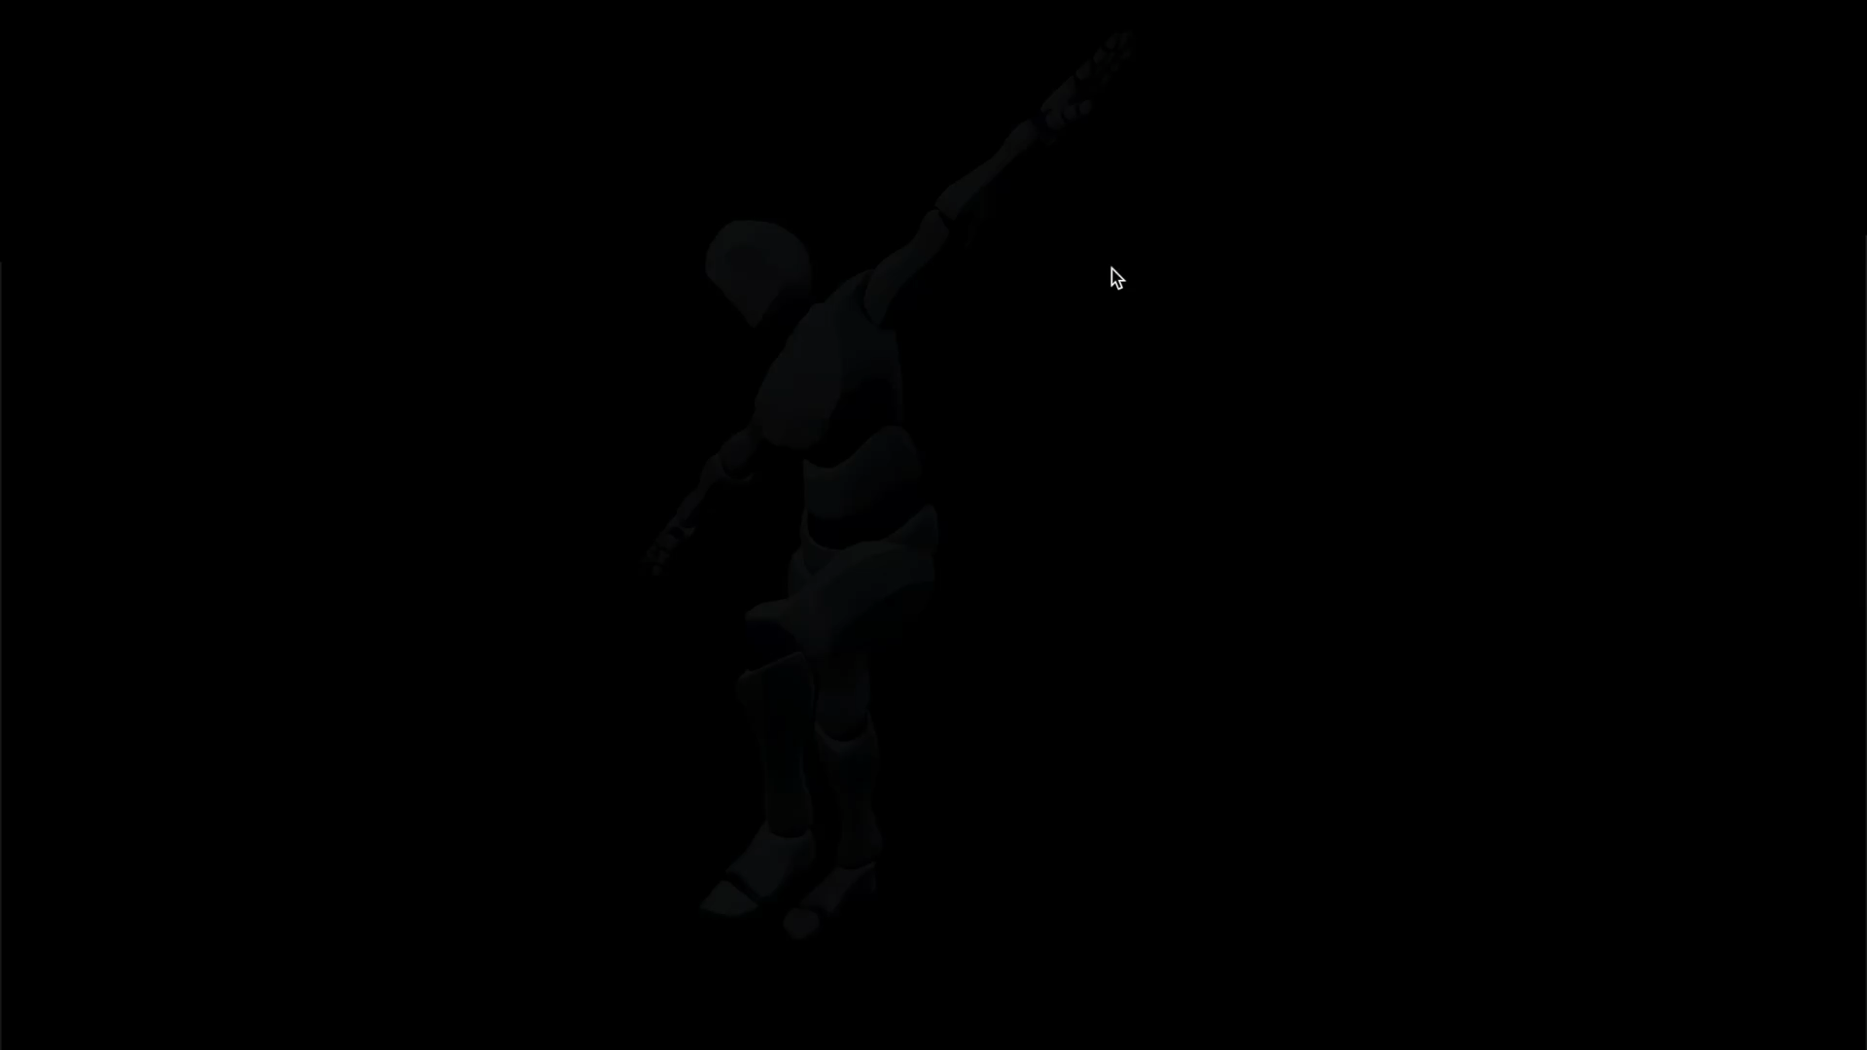
Solution overview
The final pose is divided into sub-poses
Dividing the final pose into small steps makes learning easier
Sub poses help visualize progress
Pose selection screen recording from MPALS

Slide 9

Solution overview
Before the training, the learner can get ready
Key joints give emphasis to the training, which improve results
Visualizing the pose before moving helps the learner prepare
Training screen recording (during pre training) from MPALS

Slide 10
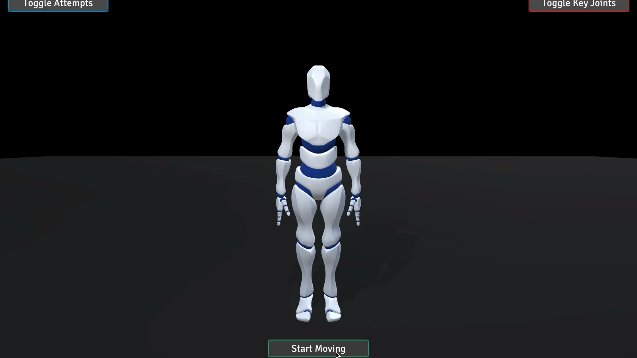
Solution overview
During the training, the learner receives feedback
The learner’s avatar moves as the learner moves
The color coding gives feedback to the learner during movement
Training screen recording (during training) from MPALS

Slide 11
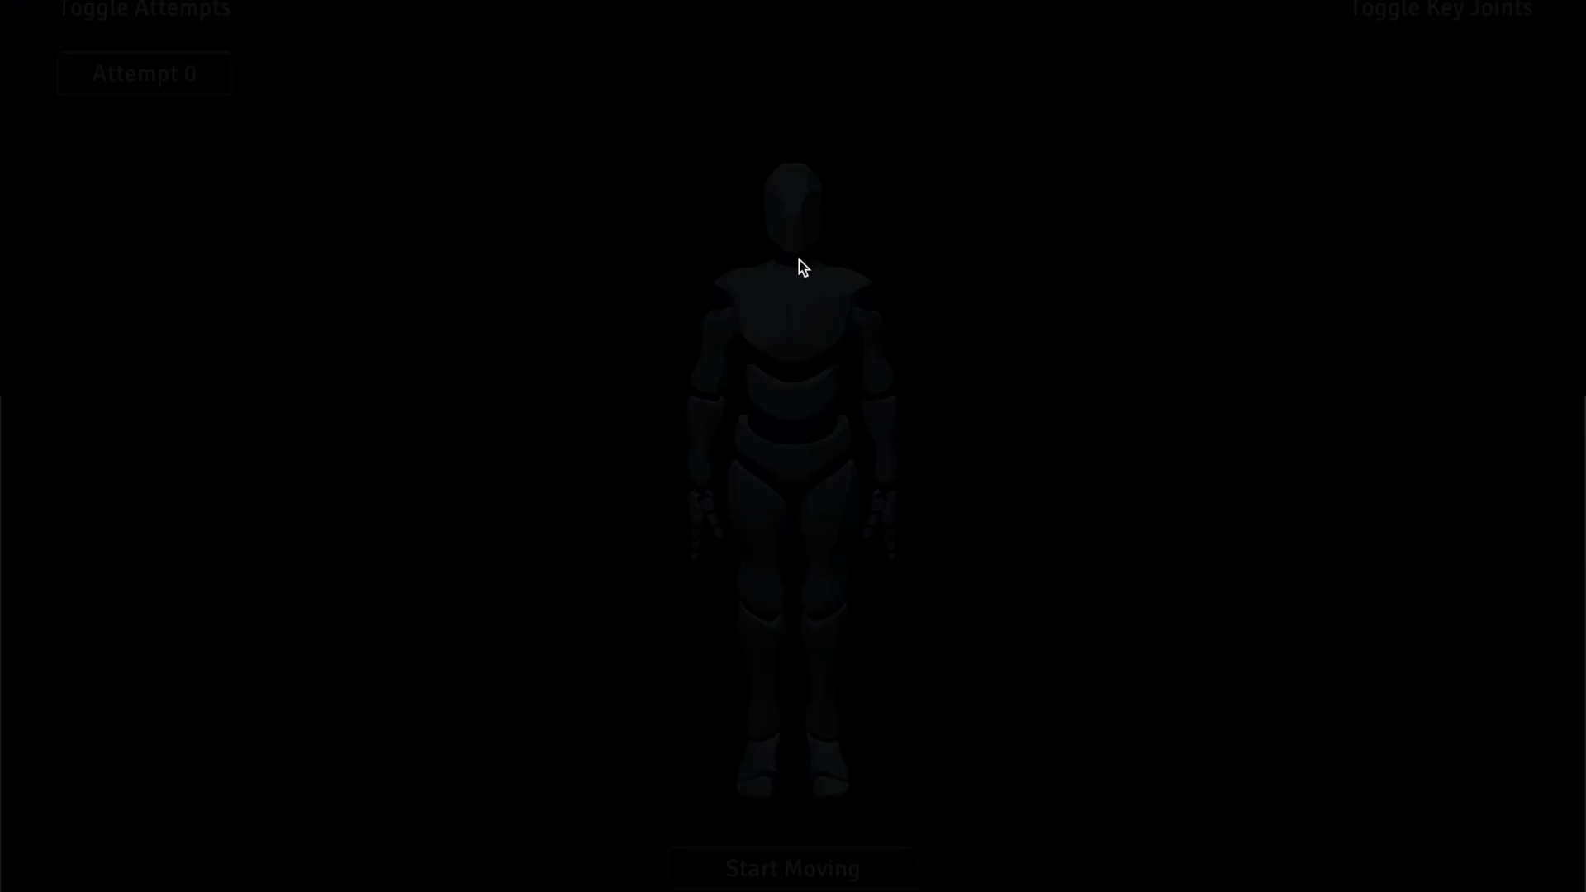
Solution overview
The learner can then analyse the movement
Without time pressure, the learner can see the movement with detail
The learner can see its movement from different angles
Terminal feedback screen recording from MPALS

Slide 12
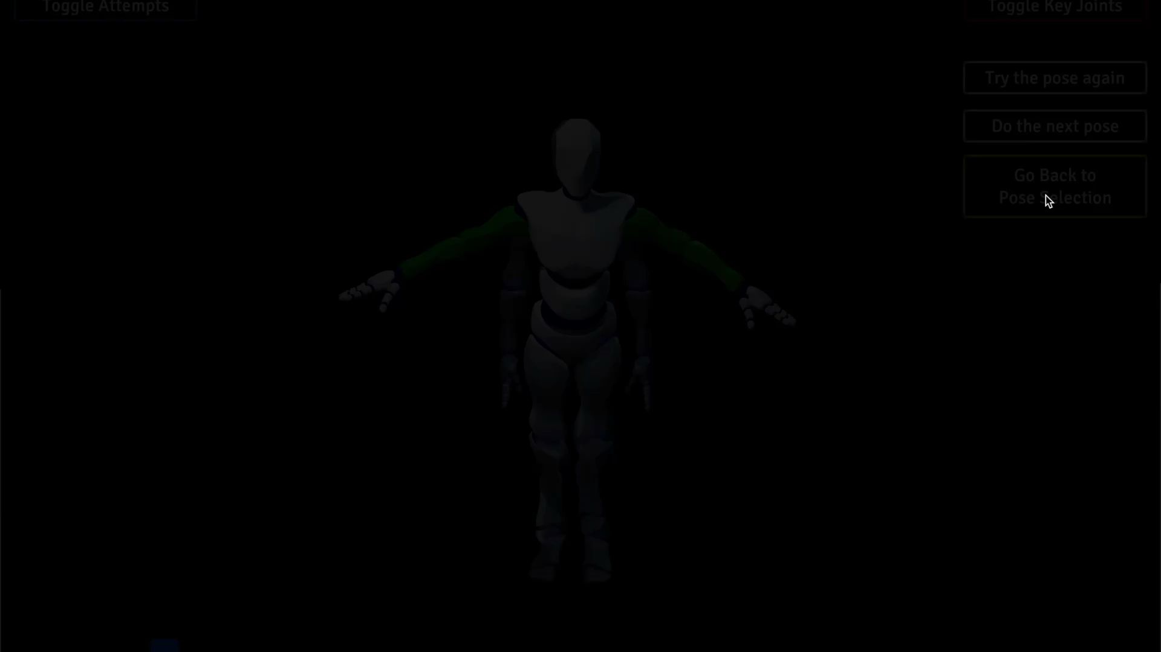
Solution overview
After doing one pose, the next poses are unlocked
The learner decides on the pace: continue to next pose or try the same one again
Pose selection screen recording from MPALS

Slide 13



Implementation
The software is divided into client and backend
Client
Backend
UI
Name, email, etc.
Database
Time records
Performance score
Human Avatar Display
Stream of Joint rotations
Human
Avatar
Processor
Support of CHL*
Uses Google Blaze Pose
Camera
Stream of images
*Cyber Human Lab – part of the Institute for Manufacturing of the University Of Cambridge

Slide 14
User study
16 participants tested MPALS, 8 were observed
The Time spent on the following activities was tracked:
Pose selection: selecting the pose
Pre teaching: after the pose is selected, before the training starts
Training: the participant moves
Analysis: the participant reviews the movement
The performance of the participants doing the pose was tracked and stored every 0.2 seconds
Performance score is computed from the joint rotation difference
The participants answered two questionnaires afterwards
Raw TLX: Analyses the effort of using the tool [4]
UE-SF: Analyzes how engaged the users were using the tool [5]

Slide 15
User study
Much was learned from simply observing learners
The dialogs are read very quickly: participants usually just want to get to the activity as quickly as possible
Possible improvement: tutorial-like explanation. Gustavo asks the learner to do something, and the learner can only continue after action is successfully performed.
Key joint functionality is not used enough
One one out of the eight participants used it
Even after Gustavo points the user that It can help with focus
Possible improvement: tutorial-like explanation
After finishing the pose, participants were somewhat lost
Even if Gustavo explains how to continue
Possible improvement: animation after successfully finishing a pose

Slide 16
User study
On average participants spent 5min 56s on MPALS
The time distribution per activity follows expectations
As the trainees get used to MPALS, they need less time
Many recommendations by Gustavo increase time spent on the first pose

Slide 17
User study
We use the score to measure the learners’ performance
Successful attempt: the learner reached a score larger than 0.95 for at least 20 frames
Out of 80 training attempts, 73 were successful
The 7 unsuccessful attempts, were not unique: the learner tried the same pose again before or after the unsuccessful attempt.
Conclusion:
The feedback was successful in pointing the learner to an attempt that did not work
Important note: doing a successful training attempt is not a condition to continue. But users choose to continue only after the attempt is successful

Slide 18
User study
Raw-TLX: The tool was perceived as easy to use
Average: 33.80

Slide 19
User study
UE-SF: The engagement was high, but could be higher
Average: 63.80%

Slide 20
Conclusion
We can answer the research question positively
Is it feasible to develop a pose teaching system that uses simple hardware (only a camera, screen, and an internet connection), that follows teaching principles, and that users find engaging and easy to use? → YES
MPALS is a first step towards a generalized pose teaching software
Big user study groups can be organized thanks to MPALS: the software can be sent over the internet, and participants’ data can be gathered with ease
The technology behind MPALS can be used for multiple use cases
A new service just must connect to the backend and send images, to receive a stream of joint rotations that can be used for therapy, ergonomics, etc.
Projects such as YouMove [1] do not need to use Kinects and expensive hardware

Slide 21
Backup

Slide 22
Background
General teaching principles
Cognitive load: Amount of working memory resources being used [6].
The learner’s cognitive load should be spent on the task itself, and not on the tool
Guided activity principle: learning with a personalized learning agent works better than with objective instructions (example: Duolingo and Duo) [7]
Pacing principle: Allow students to process smaller pieces of information in working memory by letting them decide the pace of their own learning [7]
Pre-training principle: Students learn better when there is guidance before the training [7]

Slide 23
Background
Pre-teaching principles
How the pretraining should be designed depends on the task, but pre training principles exist to design it well [8]:
Mastery goal orientation: Goal that is focused on increasing the competence of a task works better than orienting with the goal of reaching a specific metric [8]
Attentional advice: Administer information about the process or strategy needed to learn most. Proven to improve learners’ performance [8]
Gustavo gives this type of advice

Slide 24
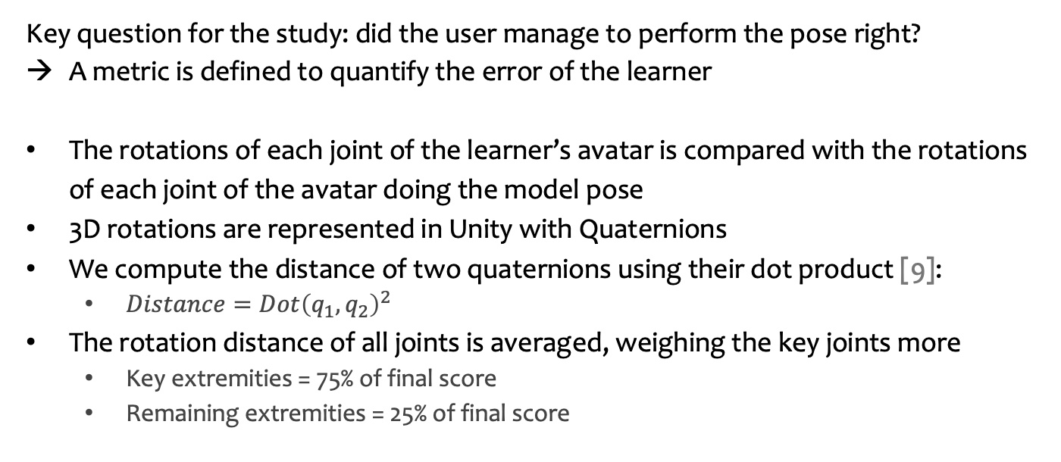
Implementation
Score calculation
Key question for the study: did the user manage to perform the pose right?
A metric is defined to quantify the error of the learner
The rotations of each joint of the learner’s avatar is compared with the rotations of each joint of the avatar doing the model pose
3D rotations are represented in Unity with Quaternions
We compute the distance of two quaternions using their dot product [9]:
$Distance=Dot{\left(q_{1},q_{2}\right)}^{2}$
The rotation distance of all joints is averaged, weighing the key joints more
Key extremities = 75% of final score
Remaining extremities = 25% of final score

Slide 25
User Study
Raw-TLX survey in detail: rate ease-of-use of MPALS
Participants rank each subscale between with a number between 5 and 100 [4]
Effort | How hard did you have to work (mentally and physically) to accomplish your level of performance?
Frustration | How insecure, discouraged, irritated, stressed and annoyed versus secure, gratified, content, relaxed and complacent did you feel during the task?
Mental Demand | How much mental and perceptual activity was required (e.g. thinking, deciding, calculating, remembering, looking, searching, etc)? Was the task easy or demanding, simple or complex, exacting or forgiving?
Performance | How successful do you think you were in accomplishing the goals of the task set by the experimenter (or yourself)? How satisfied were you with your performance in accomplishing these goals?
Physical Demand | How much physical activity was required (e.g. pushing, pulling, turning, controlling, activating, etc)? Was the task easy or demanding, slow or brisk, slack or strenuous, restful or laborious?
Temporal Demand | How much time pressure did you feel due to the rate of pace at which the tasks or task elements occurred? Was the pace slow and leisurely or rapid and frantic?

Slide 26
User Study
UE-SF survey: how engaging is MPALS?
Participants rank each question in a seven-point scale [5]
Aesthetic Appeal | The application was attractive. The application was aesthetically appealing. The application appealed to my senses.
Focused Attention | I lost myself in this experience. The time I spent using the application just slipped away. I was absorbed in this experience.
Perceived Usability | I felt frustrated while using the application I found the application confusing to use. Using the application was demanding
Reward | Using the application was worthwhile. My experience was rewarding. I felt interested in this experience.

Slide 27
Bibliography

Slide 28
Bibliography
[1]: Fraser Anderson, Tovi Grossman, Justin Matejka, and George Fitzmaurice. “YouMove: Enhancing Movement Training with an Augmented Reality Mirror”. In: Proceedings of the 26th Annual ACM Symposium on User Interface Software and Technology. UIST’13. St. Andrews, Scotland, United Kingdom: Association for Computing Machinery, 2013, pp. 311–320. isbn: 9781450322683. doi: 10.1145/2501988.2502045.
[2]: Zhengyou Zhang. “Microsoft Kinect Sensor and Its Effect”. In: IEEE MultiMedia 19.2 (2012), pp. 4–10. doi: 10.1109/MMUL.2012.24.
[3]: Ivan Grishchenko, Valentin Bazarevsky, Andrei Zanfir, Eduard Gabriel Bazavan, Mihai Zanfir, Richard Yee, Karthik Raveendran, Matsvei Zhdanovich, Matthias Grundmann, and Cristian Sminchisescu. BlazePose GHUM Holistic: Real-time 3D Human Landmarks and Pose Estimation. 2022. doi: 10.48550/ARXIV.2206.11678.
[4]: Sandra G. Hart. “Nasa-Task Load Index (NASA-TLX); 20 Years Later”. In: Proceedings of the Human Factors and Ergonomics Society Annual Meeting 50.9 (Oct. 2006), pp. 904–908. issn: 1071-1813. doi: 10.1177/154193120605000909.
[5]: Heather L. O’Brien, Paul Cairns, and Mark Hall. “A practical approach to measuring user engagement with the refined user engagement scale (UES) and new UES short form”. In: International Journal of Human-Computer Studies 112 (Apr. 2018), pp. 28–39. issn: 1071-5819. doi: 10.1016/j.ijhcs.2018.01.004.

Slide 29
Bibliography
[6]: Jeroen J. G. van Merriënboer and John Sweller. “Cognitive Load Theory and Complex Learning: Recent Developments and Future Directions”. In: Educational Psychology Review 17.2 (June 2005), pp. 147–177. issn: 1573-336X. doi: 10.1007/s10648-005-3951- 0.
[7]: Roxana Moreno and Richard Mayer. “Interactive Multimodal Learning Environments”. In: Educational Psychology Review 19.3 (June 2007), pp. 309–326. issn: 1573-336X. doi: 10.1007/s10648-007-9047-2.
[8]: Jessica Mesmer-Magnus and Chockalingam Viswesvaran. “The role of pre-training interventions in learning: A meta-analysis and integrative review”. In: Human Resource Management Review 20.4 (Dec. 2010), pp. 261–282. issn: 1053-4822. doi: 10.1016/j.hrmr. 2010.05.001.
[9]: Du Q. Huynh. “Metrics for 3D Rotations: Comparison and Analysis”. In: Journal of Mathematical Imaging and Vision 35.2 (June 2009), pp. 155–164. issn: 1573-7683. doi: 10.1007/s10851-009-0161-2.
[10]: Google LLC. Mediapipe Pose Documentation. Oct. 11, 2022. url: https://google.github. io/mediapipe/solutions/pose.html.

